Slide 1
Tobacco & Cancer Data Analysis
Database Management
By
Ashish Kumar
11711039

Slide 2
Tobacco & Cancer
Tobacco use is a leading cause of cancer and of death from cancer. People who use tobacco products or who are regularly around environmental tobacco smoke (also called secondhand smoke) have an increased risk of cancer because tobacco products and secondhand smoke have many chemicals that damage DNA.
Tobacco use causes many types of cancer, including cancer of the lung, larynx (voice box), mouth, esophagus, throat, bladder, kidney, liver, stomach, pancreas, colon and rectum, and cervix, as well as acute myeloid leukemia. People who use smokeless tobacco (snuff or chewing tobacco) have increased risks of cancers of the mouth, esophagus, and pancreas.

Slide 3
Objectives
Consumption of Tobacco by population in India( Male and Female)
Total mortality rate of population in India.
Total average mortality rate of Males in India.
Total average mortality rate of Females in India.
Average Max Price of Tobacco in India.

Slide 4
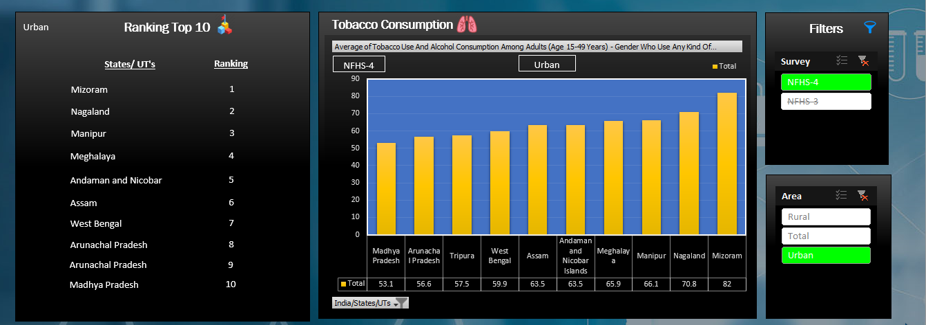
Objective 1

Slide 5
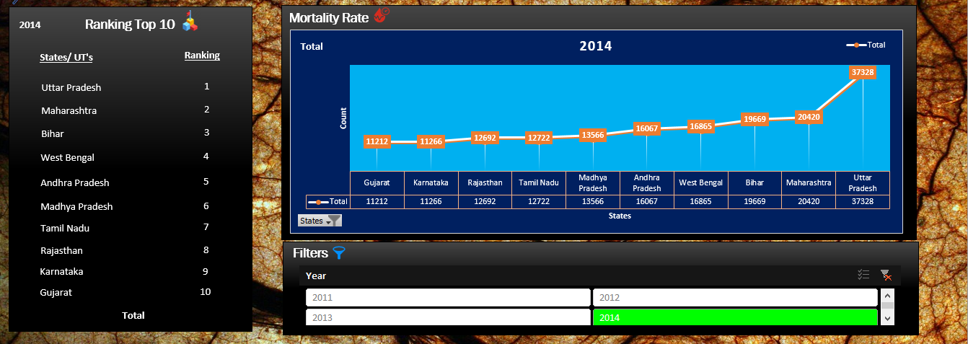
Objective 2

Slide 6
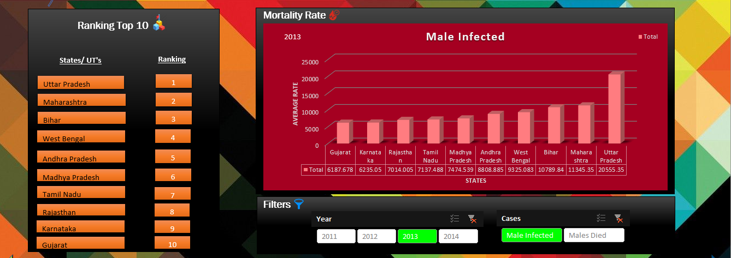
Objective 3

Slide 7
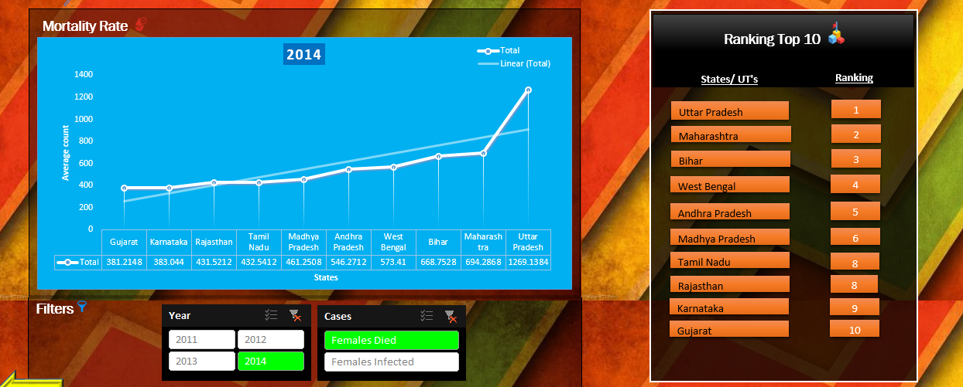
Objective 4

Slide 8
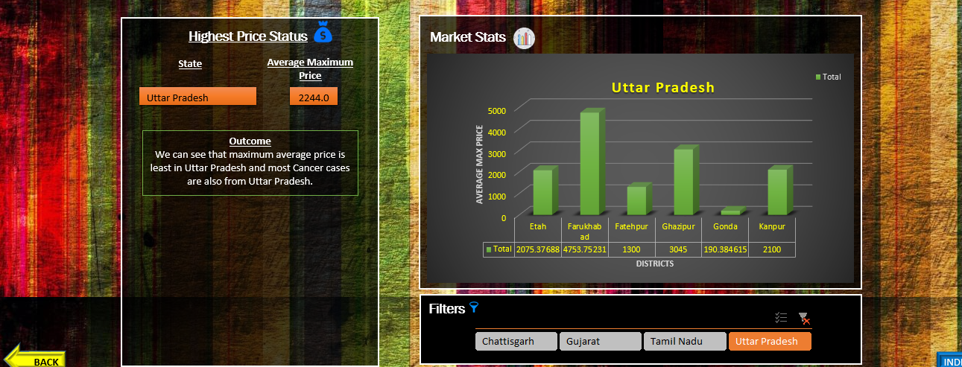
Objective 5

